Slide 1
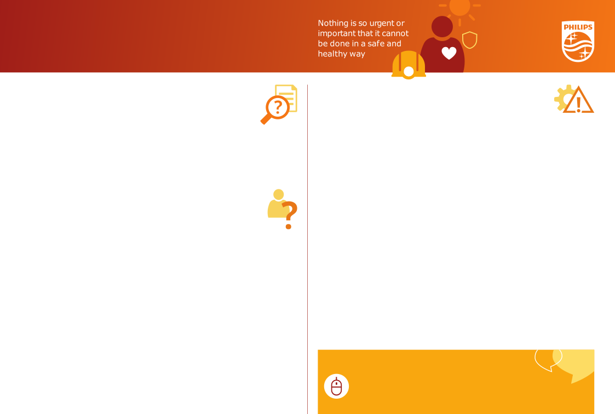



Mental Health Champion Tips For Success-
Participating in MH Champion Training
Remember:
Be present!
What you put in is what you get out
Honesty and Respect
Keep and open mind
Keep confidentiality
Use “I” statements
Safeguard and observe your personal boundaries!
Create trust in a safe environment
Ensure you can commit to the MHC training 100%
Reach out for support to IWI or MHC team/facilitators
Use you time, energy and enthusiasm to get the most out of this program
Access the free resources at https://www.stress.org.uk/free-resources-2021/
Avoid scheduling meetings immediately before and after training sessions.
Limit distractions
Go on “do not disturb”
Block off your calendar and add a little buffer to ensure no interruptions

Slide 2
Finding Balance between the MHC Role and Primary Job Function
Wearing Another “Hat”
What you can always do in any role: I.D.E.A.L.S.
Manage your time
Be aware of any ethical conflict that may arise
Communicate well
Pay attention to details
Always work with integrity in your primary role
“Refer” employee to another Champion if you feel that your primary job function capability is compromised or there is potential for conflict
Assess the potential for adverse outcomes
Prioritize what is in the best interest for all
Reach out to fellow Champions for support and guidance
Personal Boundaries
MHC Role
Primary Role
This is the point in which roles overlap. Here are some tips to help you stay successful! Be aware of your own boundaries.

Slide 3



Setting up Check-In’s
General Information
Tips for Virtual Meetings
Tips for In Person Meetings
Keep your camera on, optional for your colleague
Include a nice background on your profile (ice breaker)
Encourage them to get a drink before you start
Sit sideways (not face on) to screen
Choose a safe, environment friendly location to meet
Ask the person where they would like to meet (i.e for a coffee)
Consider a “walk and talk”
Find casual seating (sitting to the side, not face on) to colleague and avoid barriers when possible (masks, desks)
Be on time, this shows commitment and care
Be as prepared as possible
Always act with integrity, responsibility and accountability
Remember to use positive body language
Start with opener unrelated to topic (A.C.T)
Build in buffer time at end of meeting
Support and signpost!
Do not give advice

Slide 4
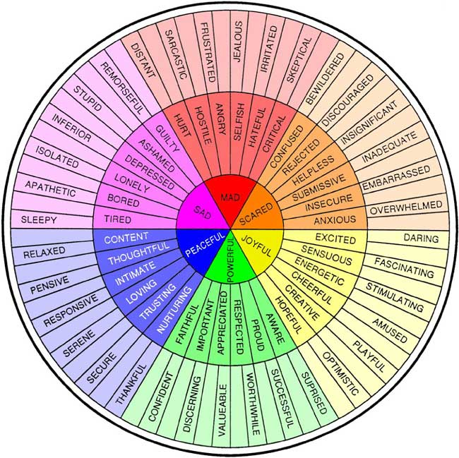
I.D.E.A.L.S
Use “I.D.E.A.L.S” to guide you!
I-Identify the early indicators of risk or mental ill-health
D-Develop a connection (A.C.T)
E-Engage in conversation
A-Actively encourage them to be open about how they are feeling (feelings wheel)
L-Listen empathetically and without judgement
S-Support and signpost to support resources, professional help

Slide 5
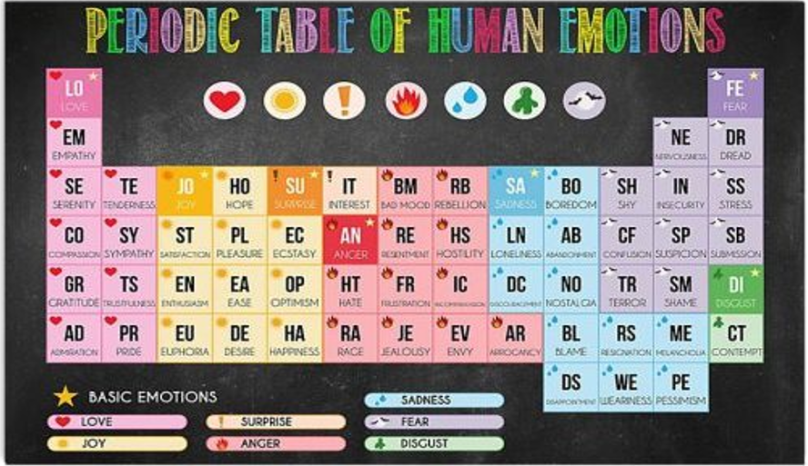
Human Emotions Table

Slide 6
Escalation Proposal
Remember to Safeguard
Safety is your #1 priority-You cannot effectively intervene in a potential crisis if you are not safe.
Continue supportive MCH Role
Refer to MH resources, EAP and check in with employee as needed.
Is the employee displaying concerning behavior where escalation is or may be required?
No
Try to stay connected with the employee via Teams or phone
Gather information about employee’s location and situation
Use de-escalation techniques
Call for external emergency help (police/EMS)
Notify HRM once crisis is resolved (this is not part of MHC role but should be done if there is an actual or credible threat)
Yes
Yes, Employee remote
Do you strongly feel the person has intent to self-harm or is acting in a way that is a threat to others?
Yes, Employee is on-site
Ensure your own safety first.
Stay with the person (if safe to do so)
Call or have someone call security
Call for external emergency help (police/EMS)
Notify employee’s HRM once crisis is resolved (this is not part of MHC role but should be done if there is an actual or credible threat)
No
Refer to MH resources, EAP and check in with employee as needed.

Slide 7
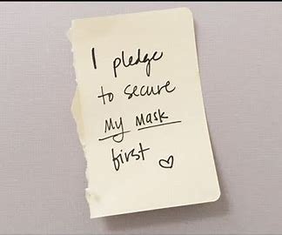
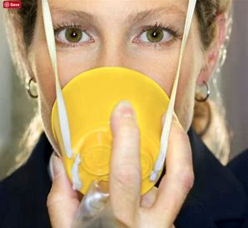
Compassion Fatigue
Put your own “oxygen mask” on before assisting others
Compassion is feeling emotions for another person, accompanied by a desire to alleviate any suffering. Fatigue is caused by weakened mental and physical exertion.
Resist absorbing the emotional suffering of others (compassion fatigue) by:
Setting and adhering to personal boundaries you establish for yourself!
Practicing self-care
Engaging in mindfulness and resilience practice (available in Philips University)
Participating in physical activities when possible
Maintaining connection with friends and engaging in fun, social activities
Getting quality sleep
Understand and recognize that this can be a normal response when caring for others.

Slide 8
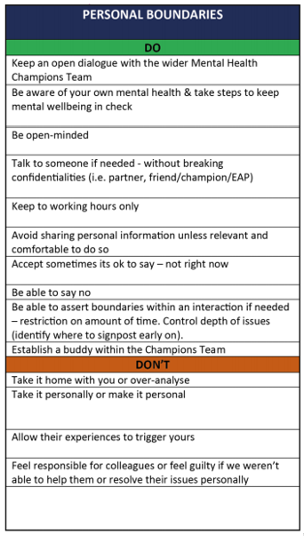
Setting Boundaries
Set your own boundaries first!
Setting your own personal boundaries is essential for you to be successful in this role.
Examples of personal boundaries
You may find many of these useful and can edit the particular boundaries to fit your own personal needs.
It is important to always remember your own personal boundaries, which may be different from those of others, in order to protect yourself and be successful as a champion.

Slide 9

Global Mental Health Resources
Be familiar with Global and local wellbeing resources you can sign-post
Global Resources by Country
This site provides local telephone numbers as well as websites for mental health support.
Philips University Learnings
Understanding & Managing your Mental Health
Stress management
Mindfulness
Mental health awareness playlist
Philips's wellbeing programs
Energy Management
Mindfulness
Resilience
Wellbeing Intranet page
Top Rated Mental Health Books
The Four Agreements: A Practical Guide to Personal Freedom (A Toltec Wisdom Book)
The Body Keeps the Score: Brain, Mind, and Body in the Healing of Trauma
Everyday Vitality: Turning Stress into Strength
How to Do the Work: Recognize Your Patterns, Heal from Your Past, and Create Your Self
Free apps that support mental health and well-being
Mindspace
Calm
Smiling Mind
Insight Timer
Stop, Breathe and Think
Notes:
As mentioned, we have many internal resources. These can be found through the intranet page if you type them into the search bar. We do have programs that are currently being piloted and more to come on that. The mental health champion pilot is being initiated to support those employees going through a chronic or acute situation where help may be available through an experienced champion who meet specific criteria to particiapte in the program. We are looking forward to being able to offer this program. There are also external resources such as the items on the right hand slide of this page. There is no shortage of books and apps aimed specifically at stress management and improving mental health. There are also global resources, so If you click on that link you can search by country and by state to find out what resources are available in your area.

