Slide 1
















THE POWER OF PAUSE
Restoring the Rhythm of You
Unplug. Exhale. Remember Who You Are.
© International Wellbeing Insights 2025 . All right sreserved

Slide 2





HOW MANY OF YOU...
This session is an intervention.
...FIND YOURSELF REGULARLY CHECKING YOUR PHONE
...HAVE EVER FELT ASHAMED OR GUILTY FOR RESTING OR RELAXING?
...HAVE NO ISSUE WITH YOUR PHONE CHECKING AND REST WHENEVER YOU NEED?
© International Wellbeing Insights 2025 . All right sreserved

Slide 3



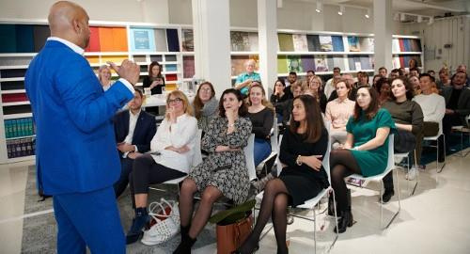
ABOUT US
The Stress Management Society is a non-profit organisation dedicated to helping individuals and companies recognise and reduce stress. We are a small organisation in West London who have been dedicated to leading effective universal change with our passionate approach to recognising and reducing stress and promoting wellbeing since 2003.
International Wellbeing Insights is the research and consultancy arm of The Stress Management Society.
Our vision is to create a happier, healthier and more resilient world.
© International Wellbeing Insights 2025 . All right sreserved

Slide 4







HOW TO USE THE WORKSHOP
Cameras on please – this is not a lecture; this is an interactive workshop. The content has been written to move on when you participate. ​
Questions will be asked throughout the session, please get involved on the microphone and the chat. This is not the facilitator’s session, it’s everyone’s session ! Put your hand up or make a request to share on the mic using the chat.​
Please feel free to ask questions, share experiences, disagree, seek clarification, tell me to slow down -whatever you need at any time.​
​
​
There will be opportunities to participate so… we need to hear from you! ​​
​​
© International Wellbeing Insights 2025 . All right sreserved

Slide 5




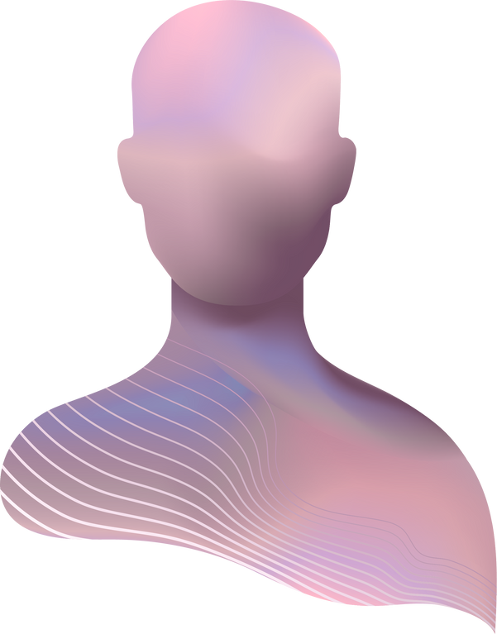






GROUND RULES: CREATING A TRUSTED SPACE
BE ON TIME
BE HERE NOW
HONESTY & RESPECT
PARTICIPATION:
WHAT YOU PUT IN IS WHAT YOU GET
USING ‘I...’ STATEMENTS
CONFIDENTIALITY
SAFEGUARDING
LIMIT DISTRACTIONS:
TECH OFF OR ON SILENT
KEEP AN OPEN MIND
Please feel free to add more in the chat section…
© International Wellbeing Insights 2025 . All right sreserved

Slide 6



THIS SESSION IS BEING RECORDED…
RECORDING IN
PROGRESS
www.stress.org.uk/public
THIS SESSION IS BEING RECORDED AND WILL BE AVAILABLE AFTER THE EVENT AT
© International Wellbeing Insights 2025 . All right sreserved

Slide 7


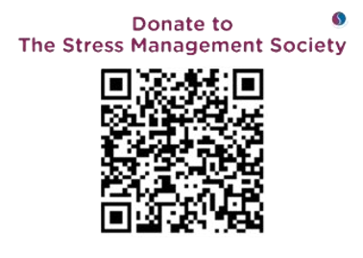









DONATE TO US
© International Wellbeing Insights 2025 . All right sreserved

Slide 8







WHAT DOES THIS STIR IN YOU?
In a world that worships speed, choosing stillness is an act of rebellion.
Pop a word or sentence in the chat
or share through the mic.
© International Wellbeing Insights 2025 . All right sreserved

Slide 9


THIS SESSION IS:
A heart-led reset.
A guided invitation to:
  Unplug from digital overload
  Reclaim time as a sacred resource
  Discover rest not as indulgence, but as intelligence
  Restore your nervous system’s natural rhythm
© International Wellbeing Insights 2025 . All right sreserved

Slide 10


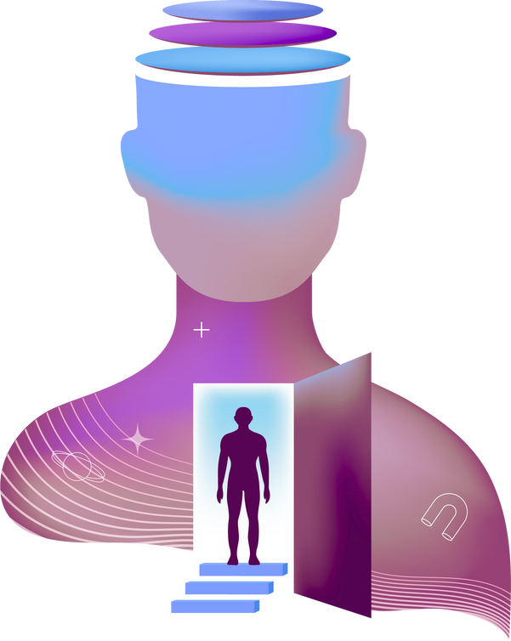



ARE WE THE "ALWAYS-ON" GENERATION?
  Wired in, logged on, hyperconnected
  But increasingly disconnected from ourselves
  We check our phones more than we check in with our hearts
  And it's making us sick, scattered, and mentally malnourished
© International Wellbeing Insights 2025 . All right sreserved

Slide 11



WHAT IS THE COST OF CONNECTION
THE HIDDEN PRICE WE PAY
  Average screen time: 7+ hours daily
  Phone checks: 96 times per day
  Attention spans: Decreased by 25% in the last decade
  Sleep disruption: 71% report screens affect their rest
  Anxiety levels: Rising correlations with digital consumption
“What’s the hidden price you think we’re paying?”.
© International Wellbeing Insights 2025 . All right sreserved

Slide 12





DIGITAL MIRROR AUDIT
WHEN LAST HAVE YOU GONE AN HOUR WITHOUT CHECKING A DEVICE?
Take 90 seconds to reflect and journal:
  How many hours did you give to your screen today?
  What did you miss while looking down?
  When did you last go an hour without checking a device?
  What emotions arise when you imagine being offline for a day?
© International Wellbeing Insights 2025 . All right sreserved

Slide 13



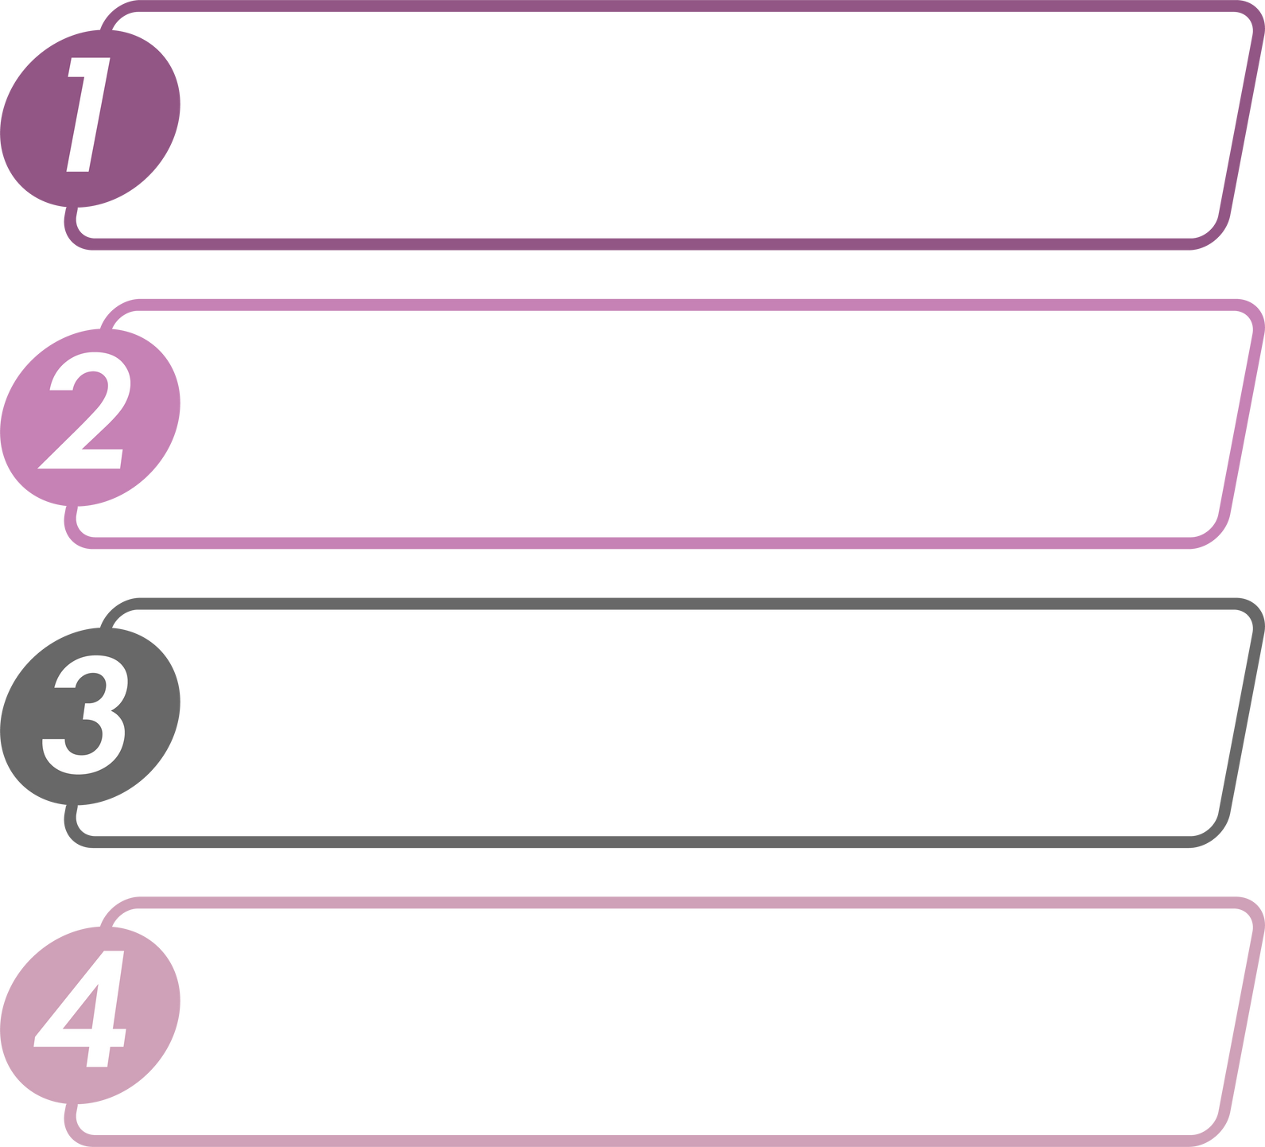
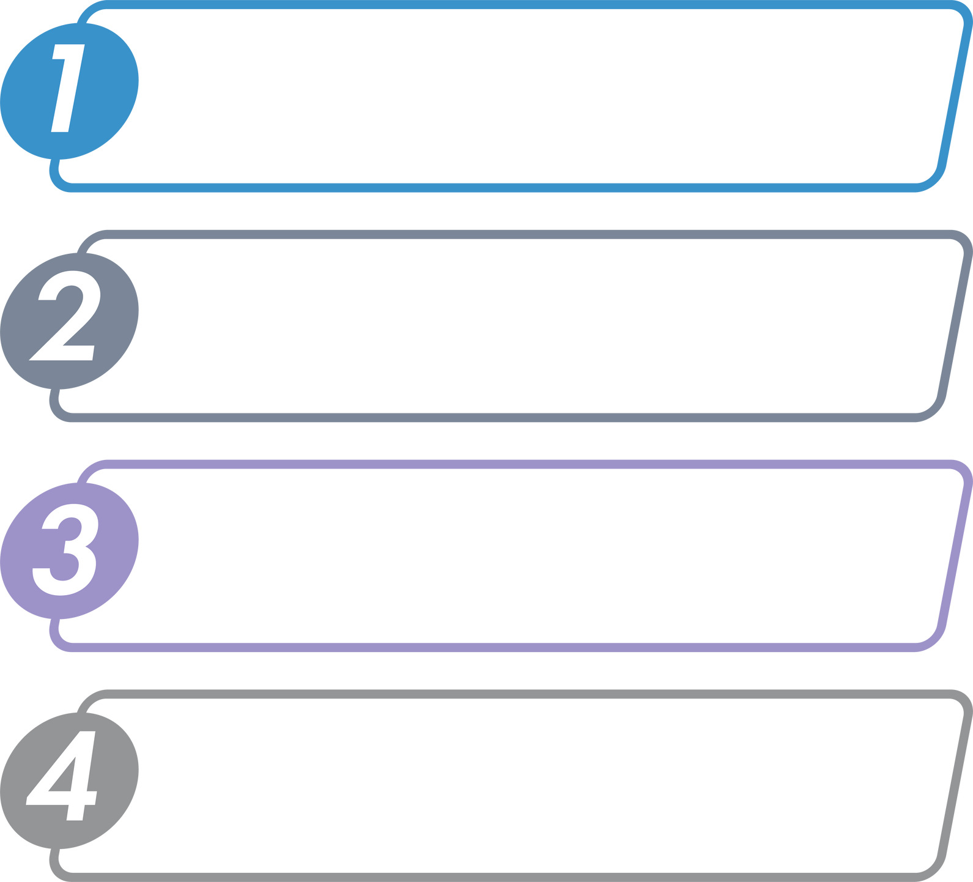





THE MODERN EPIDEMIC:
DIGITAL DETOX & INFORMATION OVERWHELM
NEWS CYCLES
A
DEPLETED SELF WORTH
INFORMATION OVERLOAD
B
“MEAN WORLD SYNDROME”
CONSTANT NOTIFICATIONS
C
FRAGMENTED ATTENTION
SOCIAL COMPARISON
D
DECISION FATIGUE
© International Wellbeing Insights 2025 . All right sreserved

Slide 14
THE MODERN EPIDEMIC:
DIGITAL DETOX & INFORMATION OVERWHELM
NEWS CYCLES
A
DEPLETED SELF WORTH
INFORMATION OVERLOAD
B
“MEAN WORLD SYNDROME”
CONSTANT NOTIFICATIONS
C
FRAGMENTED ATTENTION
SOCIAL COMPARISON
D
DECISION FATIGUE
© International Wellbeing Insights 2025 . All right sreserved

Slide 15
THE MODERN EPIDEMIC:
DIGITAL DETOX & INFORMATION OVERWHELM
NEWS CYCLES
A
DEPLETED SELF WORTH
INFORMATION OVERLOAD
B
“MEAN WORLD SYNDROME”
CONSTANT NOTIFICATIONS
C
FRAGMENTED ATTENTION
SOCIAL COMPARISON
D
DECISION FATIGUE
© International Wellbeing Insights 2025 . All right sreserved

Slide 16
THE MODERN EPIDEMIC:
DIGITAL DETOX & INFORMATION OVERWHELM
NEWS CYCLES
A
DEPLETED SELF WORTH
INFORMATION OVERLOAD
B
“MEAN WORLD SYNDROME”
CONSTANT NOTIFICATIONS
C
FRAGMENTED ATTENTION
SOCIAL COMPARISON
D
DECISION FATIGUE
© International Wellbeing Insights 2025 . All right sreserved

Slide 17
THE MODERN EPIDEMIC:
DIGITAL DETOX & INFORMATION OVERWHELM
NEWS CYCLES
A
DEPLETED SELF WORTH
INFORMATION OVERLOAD
B
“MEAN WORLD SYNDROME”
CONSTANT NOTIFICATIONS
C
FRAGMENTED ATTENTION
SOCIAL COMPARISON
D
DECISION FATIGUE
© International Wellbeing Insights 2025 . All right sreserved

Slide 18





WHAT HAPPENS WHEN WE PAUSE?
The Neuroscience of Stillness:
  Default Mode Network activates: Brain's "screensaver" promotes creativity
  Parasympathetic response: Rest-and-digest system engages
  Neuroplasticity increases: Brain becomes more adaptable
  Stress hormones decrease: Cortisol levels normalise
  Memory consolidation: Information processes into long-term storage
© International Wellbeing Insights 2025 . All right sreserved

Slide 19

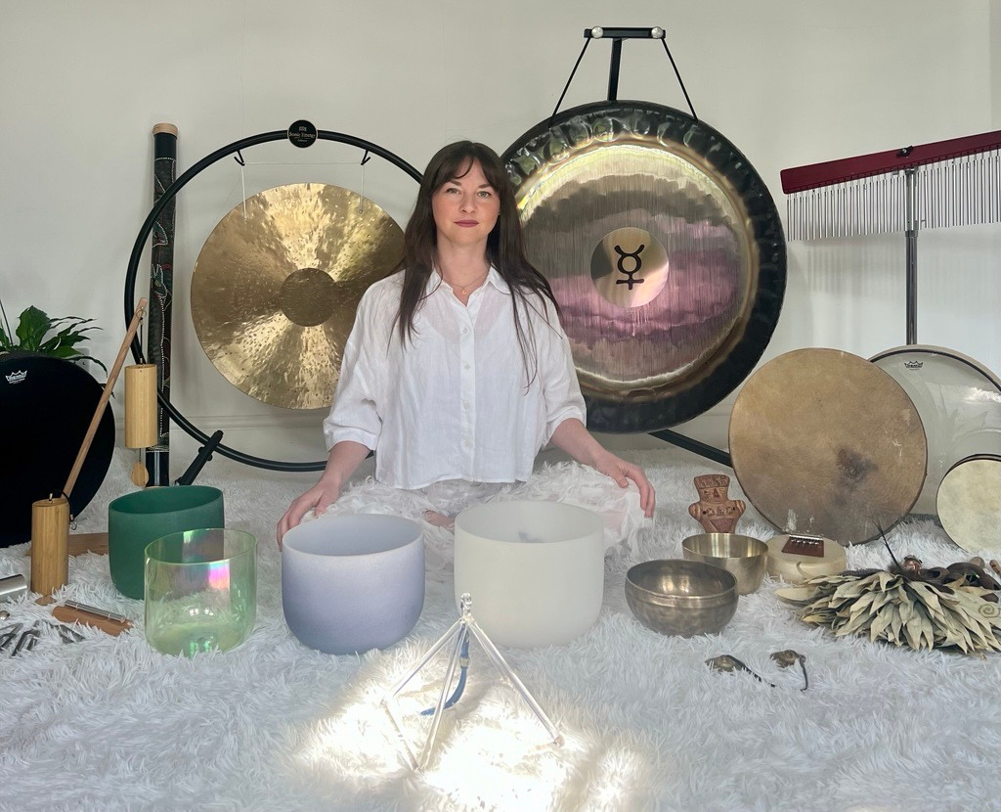



RECONNECTION PRACTICE
With Ruth Hoey
from
Re-Nurture
© International Wellbeing Insights 2025 . All right sreserved

Slide 20

HOW MANY OF YOU...
...FELT MORE CONNECTED TO YOUR BODY THAN YOUR THOUGHTS?
This session is an intervention.
...REALISED YOU’D BE HOLDING TENSION YOU DIDN’T KNOW WAS THERE?
...NOTICED NO DIFFERENCE, EVEN IF A SMALL ONE AFTER THAT SESSION?
© International Wellbeing Insights 2025 . All right sreserved

Slide 21






HOW CAN WE REDEFINE REST
REST AS INTELLIGENCE
Rest is not:
  Laziness or weakness
  Time wasted
  Something to feel guilty about
  Only for when you're "done"
Rest is:
  Strategic recovery
  Creative incubation
  Nervous system regulation
  Soul maintenance
  Revolutionary self-care
© International Wellbeing Insights 2025 . All right sreserved

Slide 22

WHAT CHANGE ARE YOU GOING TO MAKE TODAY?
So here’s the invitation:
What one thing will you change today to reclaim your rhythm?
It could be tiny: 5 minutes screen-free. A walk without your phone. Saying no to one extra thing.”
© Iternational Wellbeing Insights 2025 . All right sreserved
© International Wellbeing Insights 2025 . All right sreserved

Slide 23





MENTAL HEALTH CHAMPIONS
LEARN MORE ABOUT SAFEGUARDING, SIGNPOSTING AND SUPPORT
BOOK NOW FOR A 50% DISCOUNT COSTING YOU £248.5 FOR OUR SEPTEMBER PROGRAMME
© International Wellbeing Insights 2025 . All right sreserved

Slide 24





JOIN NEXT MONTHS WEBINAR
TUESDAY 9TH SEPTEMBER 1-2pm
SEEING BEYOND THE SMILE: UNMASKING SILENT STRUGGLES
JOIN BY CLICKING THE LINK IN THE CHAT
© International Wellbeing Insights 2025 . All right sreserved

Slide 25


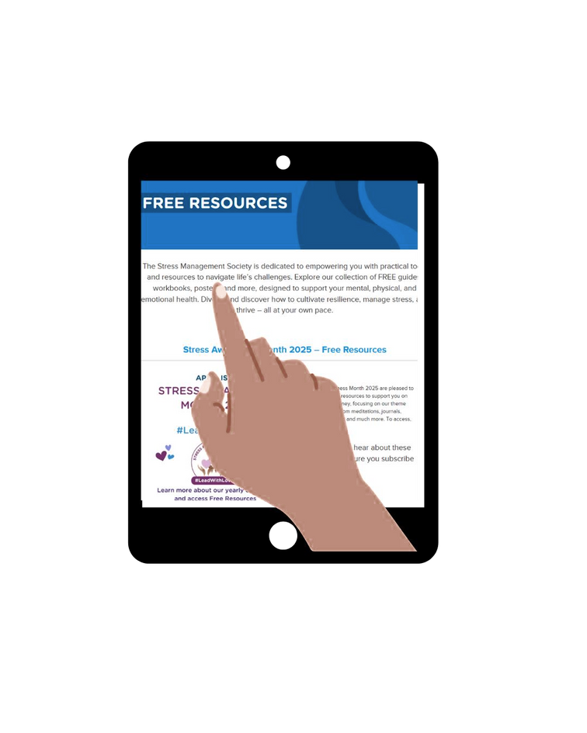





CHECK OUT OUR FREE RESOURCES
HAVE A LOOK ON OUR WEBSITE FOR A RANGE OF FREE RESOURCES!
www.stress.org.uk
© International Wellbeing Insights 2025 . All right sreserved

Slide 26


JOIN OUR PEOPLE, CULTURE AND WELLBEING FORUM
Are you a HR, Health and Safety Professional or Workplace Wellbeing Specialist?
Click the link in the chat and be part of our global community dedicated to enhancing the workplace culture around the world.
Sign up now for newsletters, webinars and further insights on workplace wellbeing so we can thrive together
© International Wellbeing Insights 2025 . All right sreserved

Slide 27



SIGN UP TO OUR WEEKLY NEWSLETTER
Are you a HR, Health and Safety Professional or Workplace Wellbeing Specialist?
© International Wellbeing Insights 2025 . All right sreserved

Slide 28



NEW PRODUCT-WELLBEING PROTECT
SIGN UP TO THE BE THE FIRST TO GET THE BENEFITS!
USE CODE:
WELL50
FOR 50%OFF THE ENTIRE PACKAGE FOR ONE MONTH
© International Wellbeing Insights 2025 . All right sreserved

Slide 29



WAS THIS SESSION BENEFICIAL?
IF THIS SESSION WAS BENEFICIAL PLEASE LEAVE US A GOOGLE REVIEW
© International Wellbeing Insights 2025 . All right sreserved

Slide 30

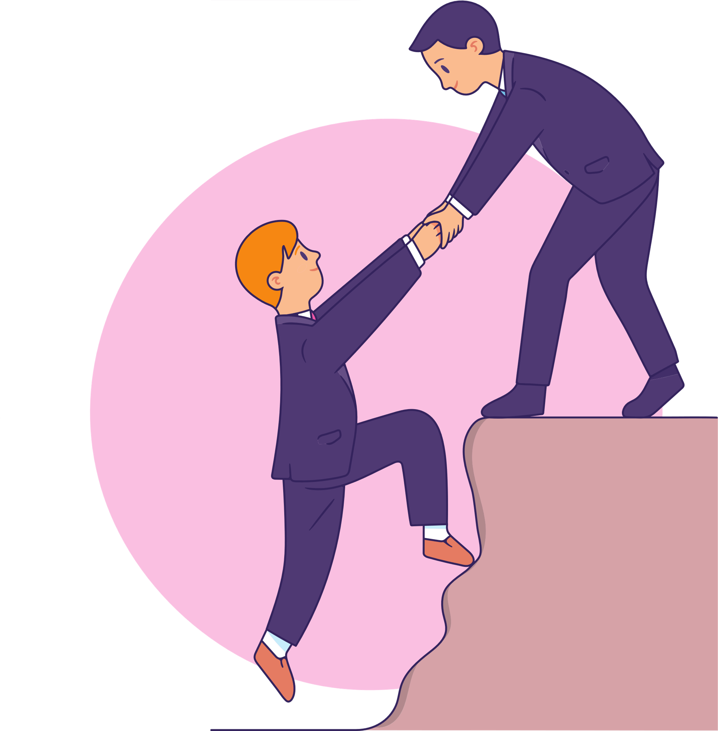



NEW EMPLOYEE ASSISTANCE PROGRAMME SUPPORT
IF THIS SESSION WAS BENEFICIAL PLEASE LEAVE US A GOOGLE REVIEW
info@stress.org.uk TO REQUEST OUR FREE EAP
PURPLE PAPER
CONTACT US FOR A EAP REVIEW DISCUSSION
© International Wellbeing Insights 2025 . All right sreserved

Slide 31




NEED TO TALK? SUPPORT RESOURCES
SAMARITANS
THE SILVER LINE
0800 470 80 90
This free helpline for older people across the UK is open every day and night. Staff offer information, friendship and advice as well as linking callers to local groups and services.
CALL: 116
This is a free listening service for whatever you are going through. No matter what, someone will be there to help talk through any distress you feel you want something to talk through with you
MIND
www.mind.org.uk
Call: 03001233393 (09.00-18.00)
C.A.L.M.
(CAMPAIGN AGAINST LIVING MISERABLY) www.thecalmzone.net/help/get-help/ CALL: 0800 58 58 58 (5PM –MIDNIGHT, DAILY)
Text: 86463
Mind provide advice and support to
empower anyone who might be
experiencing mental health
problems. They have a range of
services including supported
housing, crisis helplines, drop-in
centre, counselling and befriending
This campaign aims to help anyone who
may have hit a wall for any reason at all
and want to talk to someone or find information and support
© International Wellbeing Insights 2025 . All right sreserved

Slide 32





WHAT DO YOU NEED TO ASK BEFORE WE END THE SESSION?​
This is an opportunity to ask us any questions or reflections from todays session.
© International Wellbeing Insights 2025 . All right sreserved

Slide 33






We look forward to supporting your wellbeing journey…
info@stress.org.uk
+44(0)
203 142 8650
www.stress.org.uk
The Lighthouse Suite S, Quay West Salamander Quay Harefield, Middlesex UB9 6NZ
© International Wellbeing Insights 2025 . All right sreserved

